Slide 1
Asset Return vs Market Return
Aspect | Asset Return | Market Return
Definition | Specific investment return, often as a percentage. | Return on market index like S&P 500, expressed as a percentage.
Volatility | Volatile due to individual asset characteristics. | Less volatile but still affected by market-wide fluctuations.
Examples | Stock, bond, mutual fund, or real estate investment returns. | S&P 500 index for U.S. stocks, the FTSE 100 for UK stocks, or the MSCI World Index for global equities.
Notes:
Asset return represents the performance of a specific investment, typically subject to significant volatility due to individual characteristics, while market return reflects the overall performance of a broader market index and tends to be less volatile, encompassing a diverse range of investments such as the S&P 500, FTSE 100, or MSCI World Index for various geographical markets.
FTSE 100: Financial Times Stock Exchange 100 Index.
MSCI: Morgan Stanley Capital International
MSCI World Index is the "MSCI ACWI (All Country World Index) World Index.“

Slide 2
Market Risk Exposure
Type of Market Risk | Description | Management Strategies
Equity Risk | Risk of losses due to fluctuations in stock prices | Diversification, Portfolio Optimization
Interest Rate Risk | Risk of losses due to interest rate movements | Hedging, Asset Liability Management
Currency Risk (FX Risk) | Risk from changes in exchange rates | Hedging, Currency Swaps
Commodity Price Risk | Risk tied to fluctuations in commodity prices | Hedging, Commodity Futures Contracts
Systemic Risk | Risk of a widespread financial system collapse | Stress Testing, Diversification
Volatility Risk | Risk associated with sudden market volatility | Volatility Derivatives, Options Strategies
Liquidity Risk | Risk related to difficulty in buying/selling assets | Cash Reserves, Asset-Liability Matching
Credit Risk | Risk of counterparties failing to meet obligations | Credit Analysis, Credit Derivatives
Regulatory Risk | Risk due to changes in financial regulations | Compliance, Regulatory Compliance Assessment
Notes:
Market risk exposure encompasses various types of risks, including equity, interest rate, currency, and commodity price risks, along with systemic, volatility, liquidity, credit, and regulatory risks, representing the vulnerability to adverse market movements and conditions, which can be managed through diversification and risk mitigation strategies.

Slide 3
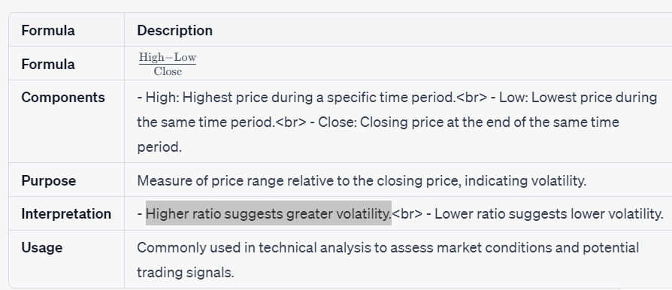
High-Low Range Percentage: Assessing Volatility Relative to Closing Price
Notes:
The formula (High - Low) / Close, known as the "High-Low Range Percentage," measures the relative price range to the closing price, offering insights into the level of volatility in financial markets.

Slide 4
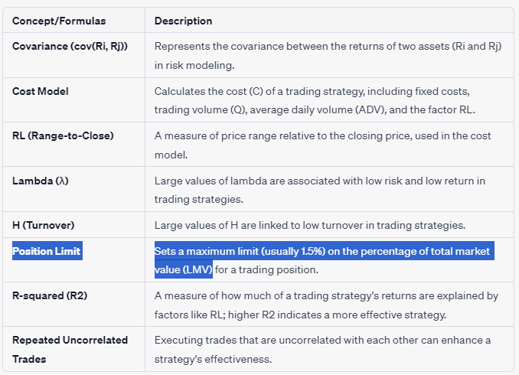
Risk-related Concepts and Formulas
Notes:
In quantitative finance, covariance (cov(Ri, Rj)) measures the relationship between asset returns, while the cost model (C) calculates trading expenses based on factors like trading volume (Q) and the high-low range relative to the closing price (RL), with concepts like lambda (λ), turnover (H), position limits, and R-squared (R2) influencing trading strategy risk and effectiveness.

Slide 5

Cost Calculation Formula for Trading Strategies
Cost in trading strategies can be calculated using the formula C = Fixed cost + B * RL * (Q / ADV)^0.5, where fixed cost, coefficient B, the range-to-close ratio (RL), the number of shares to be traded (Q), and the average daily trading volume (ADV) are key components influencing the total cost.
Simplified formula: C = (High - Low) *Q/2
Notes:
Cost in trading strategies can be calculated using the formula C = Fixed cost + B * RL * (Q / ADV)^0.5, where fixed cost, coefficient B, the range-to-close ratio (RL), the number of shares to be traded (Q), and the average daily trading volume (ADV) are key components influencing the total cost.

Slide 6
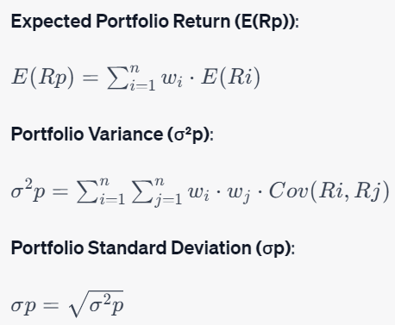
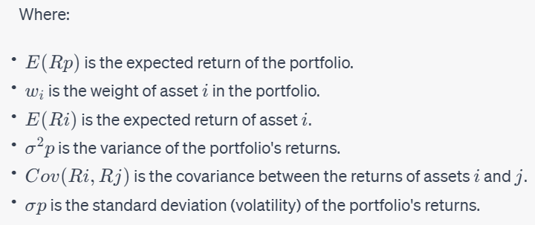
Key Components of Portfolio Optimization
Portfolio optimization seeks ideal weights to maximize returns, minimize risk, adhering to constraints like budget allocation (sum of weights equal to 1) and asset limits.
Portfolio optimization varies with goals, risk tolerance; uses techniques like Mean-Variance Optimization (MVO) or the Capital Market Line (CML); adapts to investor preferences and constraints.
Portfolio optimization complexity involves factors like risk-free rates, target returns, and allocation constraints tailored to investor or manager objectives.
Notes:
Portfolio optimization, a fundamental concept in finance, utilizes mathematical formulas to strike a balance between a portfolio's expected return and risk, taking into account the weights and expected returns of individual assets and their interrelationships measured by covariance. By finding the optimal asset allocation, investors aim to maximize returns or minimize risk based on their unique investment objectives and constraints.
Expected Portfolio Return (E(Rp)): Calculated by weighing the expected returns of individual assets.
Portfolio Variance (σ²p): Measures portfolio risk, considering asset returns' covariance and weights.
Portfolio Standard Deviation (σp): The square root of portfolio variance, representing volatility.
wi (Asset Weights): Reflects the allocation of investment; indicates the proportion of each asset in the portfolio.
E(Ri) (Expected Asset Return): Expected return of each asset, derived from historical data or forecasts.
Cov(Ri, Rj) (Covariance): Measures how asset returns move together or diverge, affecting portfolio risk.
These components are integral to portfolio optimization, helping investors balance risk and return in their investment decisions.
These two concepts, budget allocation and allocation constraints, serve different purposes in portfolio management. Budget allocation focuses on dividing available capital among assets, while allocation constraints set boundaries on how much can be invested in individual assets or categories, often for risk control or regulatory compliance.

Slide 7
Trading Strategies
Strategy | Description | Advantages | Limitations
Buy and Hold | Long-term investment; passive strategy. | - Minimal trading costs. - Potential for long-term capital appreciation. - Simplicity and ease of execution. | - Vulnerable to market downturns. - May miss short-term opportunities. - Requires patience and discipline during market fluctuations.
Day Trading | Intraday trading, aiming to profit from short-term price movements. | - Potential for quick profits. - High trading activity can yield frequent opportunities. - No overnight risk. | - High transaction costs (commissions, spreads). - Requires substantial time, focus, and expertise. - Risk of significant losses due to volatility.
Swing Trading | Captures short to medium-term price swings within trends. | - Potential for intermediate-term gains. - Less intense than day trading. - Opportunity to capitalize on market trends. | - Holding positions can lead to overnight risk. - Requires technical analysis skills. - May involve holding through retracements.
Value Investing | Seeks undervalued assets for long-term growth. | - Focuses on fundamentals and intrinsic value. - Potential for significant long-term returns. - Less market timing required. | - May require patience during market corrections. - Value may not be realized for an extended period. - Can involve significant research and analysis.
Trend Following | Trades in the direction of established trends. | - Potential for profit during trend continuation. - Utilizes technical indicators for decision-making. - Diversification can mitigate risk. | - False signals in choppy or range-bound markets. - May enter trends late or exit early. - Vulnerable to significant market reversals.
Arbitrage | Exploits price differences in related assets/markets. | - Potential for risk-free profits. - Low to no market exposure. - Requires minimal market forecasting. | - Requires fast execution and monitoring. - Arbitrage opportunities may be short-lived. - May involve high transaction costs.
Algorithmic Trading | Automated trading using computer algorithms. | - High-speed execution and scalability. - Reduces emotional bias. - Allows for backtesting and optimization. | - Development and maintenance of algorithms require expertise. - Risk of technical failures or glitches. - May amplify market downturns if not well-designed.
Pairs Trading | Simultaneously trades two related assets. | - Attempts to profit from relative price movements. - Market-neutral strategy, hedges against market risk. - Reduces directional exposure. | - Requires identification of suitable pairs. - Correlations may change over time. - May encounter periods of low trading opportunities.
Options Trading | Uses options contracts for hedging or speculation. | - Flexible risk management and profit potential. - Can be used in various market conditions. - Strategies cater to specific risk-reward profiles. | - Complex strategies may involve significant learning curve. - Option premiums can be costly. - Timing and selection of options crucial for success.
Quantitative Strategies | Utilizes mathematical and statistical models. | - Data-driven and systematic approach. - Potential for automation and scalability. - Can identify opportunities across various markets. | - Requires advanced quantitative and programming skills. - Model risk and overfitting can lead to unexpected results. - May not adapt well to rapidly changing markets.
Notes:
Various trading strategies offer distinct advantages, such as long-term value investing growth and quick day trading profits. Still, each comes with limitations, such as potential losses in high-risk day trading and the need for patience in buy and hold, requiring investors to choose strategies that align with their risk tolerance and objectives.

Slide 8
Quantitative Strategies for Confidential Trading
Quantitative Strategy | Description | Advantages | Limitations
Randomized Trading Algorithms | Introduce randomness in trading algorithms to avoid predictable patterns. | Reduces predictability of trading strategy. | May result in suboptimal execution.
Obfuscation Techniques | Implement techniques to obscure trading signals, such as adding noise or using cryptographic methods. | Conceals true order intentions. | Increased complexity and potential for errors.
Smart Order Routing | Use algorithms to split orders across multiple venues and time intervals. | Prevents others from deducing strategy from large orders. | May incur additional costs and execution risk.
Alternative Data Sources | Incorporate unique data sources like sentiment analysis from news or social media. | Provides unconventional insights less likely to be widely used. | Data quality and interpretation challenges.
Machine Learning (ML) | Deploy adaptive algorithms driven by AI to adjust strategies in real-time. | Increases adaptability and reduces predictability. | Requires substantial computing power and expertise.
Statistical Arbitrage | Focus on relative value trading to profit from relative price movements. | Less conspicuous than directional bets. | Sensitivity to market regime changes.
Dark Pools | Utilize trading in dark pools and alternative venues offering anonymity. | Keeps trading activities hidden from public view. | Limited availability and potential for information leakage.
Liquidity Fragmentation | Fragment orders into smaller sizes and trade across multiple liquidity pools. | Reduces visibility of entire strategy. | Increased complexity and execution challenges.
Stochastic Optimization | Apply stochastic optimization methods to add randomness to the optimization process. | Enhances unpredictability in strategy. | Risk of suboptimal solutions and slower convergence.
Constantly Evolving Models | Continuously update and evolve quantitative models to adapt to changing market conditions. | Reduces predictability of strategies. | Demands ongoing research and development efforts.
Notes:
Quantitative strategies, including randomized algorithms, obfuscation techniques, and dark pools, enhance trading confidentiality by introducing randomness and minimizing predictability, yet they require careful diligent management and may present trade-offs and complexities.

Slide 9
Enhancing Trading Confidentiality with ML
Strategy | Description | Advantages | Considerations and Limitations
Privacy-Preserving Machine Learning | Protects sensitive data while allowing for collaborative model training. | Preserves data privacy, enables secure collaboration. | Complex implementation, potential performance trade-offs.
Algorithmic Trading with Sentiment Analysis | Combines ML and sentiment analysis to uncover hidden opportunities. | Incorporates market sentiment, enhances market understanding. | Reliance on external data sources, sentiment accuracy.
Market Microstructure Analysis | Uses ML to analyze market microstructure data, revealing subtle patterns. | Identifies trading opportunities from microstructure insights. | Requires access to granular market data, may involve high data costs.
Unsupervised Learning for Anomaly Detection | Detects anomalies in trading data using unsupervised learning. | Identifies irregular behaviors, enhances security. | Challenges in defining anomalies, potential for false positives.
Generative Adversarial Networks (GANs) | Generates synthetic trading data for backtesting and strategy development. | Maintains data confidentiality while enabling strategy testing. | Synthetic data may not fully capture market nuances.
Private Prediction Markets | Uses blockchain and smart contracts to create private prediction markets. | Confidential trading with exposure to various assets. | Regulatory and legal considerations, blockchain adoption challenges.
Customized Reinforcement Learning | Develops RL algorithms for optimizing strategies with minimized exposure. | Adapts to changing market dynamics while preserving confidentiality. | Complex algorithm development, training data challenges.
Differential Privacy | Applies differential privacy techniques to protect individual trading data. | Enhances privacy while extracting valuable insights. | Trade-off between privacy and utility, potential for noise in data.
Dark Pools and Alternative Trading Venues | Explores alternative venues prioritizing confidentiality. | Offers anonymity and privacy in trading. | Limited liquidity and access in some venues, possible information leakage.
Notes:
Machine learning-based strategies, including privacy-preserving techniques and sentiment analysis, empower traders to enhance confidentiality while leveraging data-driven insights. Yet, they demand meticulous execution and data source scrutiny.
Value based RL
Policy based RL
Developing customized reinforcement learning (RL) algorithms for trading prioritizes data privacy, minimizing the exposure of sensitive trading information while optimizing strategies and enhancing trading confidentiality.

Slide 10
Collaboration
MML: Fu Rongrong - Wong Jia Jie - Wang Lin
DRL: Yuan Han - Zhao Xuan - Wang Lin
Real estate fund: Leong Wei Ming - Wong Jia Jie - Wang Lin
2b:
Bond: Wang Lin, Zhao Xuan (T bill, 5 Sept. BS23117Z, 5.5b*1.5%)
Stock(index/equity): Rongrong, Jia Jie, Yuan Han, Wei Ming, Zhao Xuan
Notes:
Fu Rongrong - Multimodal Learning for Portfolio Optimization using factor models
Yuan Han - DRL for Portfolio Optimization (Join in at 6.30pm)
Leong Wei Ming - Optimizing Real Estate Portfolios
Wang Lin - Advanced Fundamental Analysis for Stock Forecasting
Wong Jia Jie - Multimodal Learning: Superior Returns in Equity
Zhao Xuan - Graph-Based Personalized Stock Recommendations

Slide 11
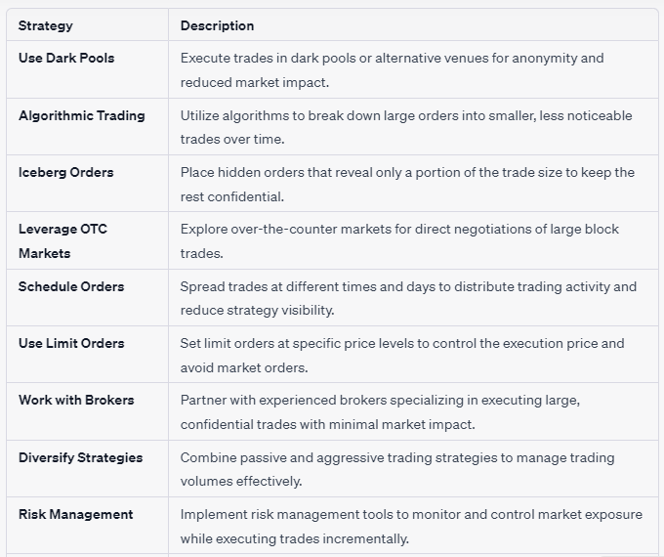
Discreet asset accumulation: enhanced confidentiality & minimized impact
Notes:
Utilize strategies like dark pools, algorithmic trading, and hidden orders to incrementally acquire assets while avoiding high trading volumes, thereby enhancing trading confidentiality.
Risk Management Implement risk management tools to monitor and control market exposure while executing trades incrementally.
These strategies help you buy assets in a way that maintains confidentiality and minimizes market impact when dealing with large trading volumes.

Slide 12
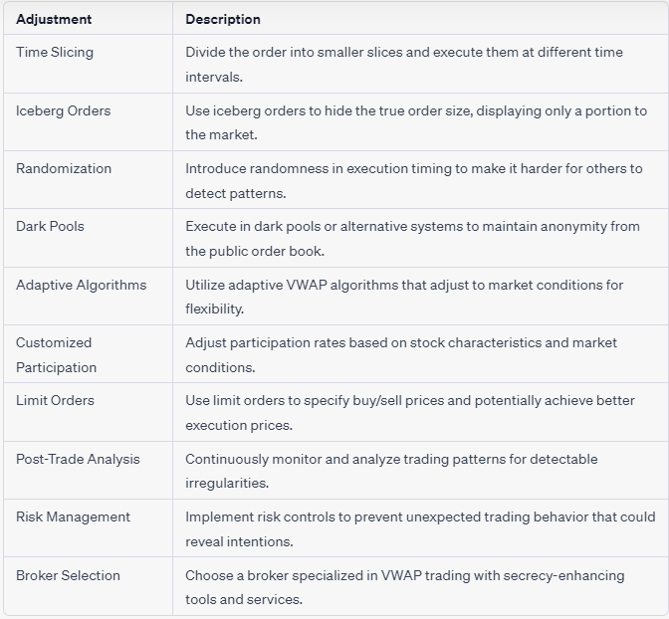
Enhancing Trading Secrecy in VWAP (Volume Weighted Average Price) Strategies
Notes:
The VWAP (Volume Weighted Average Price) algorithmic trading strategy is designed to execute trades while minimizing the market impact, which includes keeping the trading activity as discreet as possible. To improve trading secrecy in a VWAP strategy, you can consider the following adjustments:
To enhance trading secrecy in a VWAP algorithmic trading strategy, consider tactics such as time slicing, iceberg orders, randomization, dark pools, adaptive algorithms, customized participation rates, limit orders, post-trade analysis, risk management, and choosing a specialized broker.
These adjustments can help VWAP traders maintain confidentiality while executing their trading strategies.
Remember that while these adjustments can help improve trading secrecy in a VWAP strategy, no strategy can guarantee complete anonymity. It's essential to strike a balance between secrecy and execution efficiency, as overly secretive strategies might lead to poor execution or missed opportunities. Additionally, always consider compliance with market regulations and best execution principles when implementing trading strategies.
The VWAP (Volume Weighted Average Price) algorithmic trading strategy is designed to execute trades while minimizing the market impact, which includes keeping the trading activity as discreet as possible. To improve trading secrecy in a VWAP strategy, you can consider the following adjustments:
Time Slicing: Break down your order into smaller slices and execute them at different time intervals throughout the trading day. This helps avoid large, noticeable trades that can move the market.
Iceberg Orders: Use iceberg orders to hide the true size of your order. An iceberg order only displays a portion of your total order size to the market, keeping the rest hidden.
Randomization: Add an element of randomness to the execution timing. This can make it harder for other market participants to detect your trading pattern.
Dark Pools: Execute a portion of your order in dark pools or alternative trading systems that offer anonymity. Dark pools are designed to conceal order information from the public order book.
Adaptive Algorithms: Use adaptive VWAP algorithms that adjust their trading pace based on market conditions. This helps in staying flexible and adapting to changing liquidity.
Customized Participation Rates: Customize your participation rates based on the stock's trading characteristics and market conditions. Reduce participation rates in volatile markets and increase them in more stable ones.
Limit Orders: Instead of market orders, consider using limit orders. This allows you to specify the price at which you are willing to buy or sell, which can help in executing trades at better prices.
Post-Trade Analysis: Continuously monitor and analyze your trading patterns to identify any detectable patterns or irregularities. Adjust your strategy accordingly.
Risk Management: Implement risk management controls to prevent unexpected trading behavior that might reveal your intentions.
Broker Selection: Choose a broker that specializes in VWAP trading and offers tools and services designed to maintain trading secrecy.
Remember that while these adjustments can help improve trading secrecy in a VWAP strategy, no strategy can guarantee complete anonymity. It's essential to strike a balance between secrecy and execution efficiency, as overly secretive strategies might lead to poor execution or missed opportunities. Additionally, always consider compliance with market regulations and best execution principles when implementing trading strategies.

Slide 13
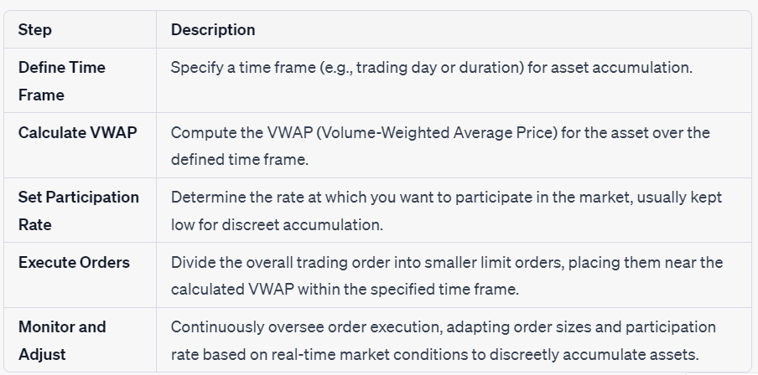
VWAP (Volume-Weighted Average Price) Algorithmic Trading for Discreet Asset Accumulation
Notes:
This strategy aims to buy or sell an asset over a specific time period while minimizing market impact. Here's how it works:
Objective: Accumulate a large position in an asset while keeping the order execution discreet to avoid impacting the market price.
Algorithmic Steps:
Define the Time Frame: Specify the time frame over which you want to accumulate the asset, such as a day or a week.
Calculate VWAP: Calculate the VWAP for the asset over the defined time frame. VWAP is the average price of all trades in a given period, weighted by their trading volume.
Set Participation Rate: Determine the rate at which you want to participate in the market. For discreet accumulation, this rate should be low to avoid drawing attention.
Execute Orders: Break down the order into smaller orders, typically executed as limit orders at or near the calculated VWAP. These orders are placed throughout the defined time frame.
Monitor and Adjust: Continuously monitor the execution of orders and adjust the participation rate or order sizes based on market conditions. If the asset's price moves away from the VWAP, adjust order prices accordingly.
Advantages:
Discreet Accumulation: By using VWAP and small, discreet orders, this strategy avoids drawing attention and minimizes the impact on the asset's price.
Market Neutrality: VWAP strategies aim to be market-neutral, meaning they don't take directional bets on the asset's price movement.
Customizable: The participation rate and order sizes can be adjusted based on the trader's discretion and the desired level of discretion.
Considerations:
Execution Risk: There is a risk that the entire order may not be filled within the specified time frame, especially if the market is illiquid.
Market Impact: While the strategy minimizes market impact, it may still influence the asset's price to some extent, especially in less liquid markets.
Costs: Algorithmic trading often incurs costs in the form of execution fees and spreads, which should be considered when implementing the strategy.
This algorithmic trading strategy allows traders to accumulate assets discreetly over a defined time frame, minimizing the impact on the market while achieving their desired position.

Slide 14
Key Considerations for the VWAP algorithmic trading strategy
Execution Risk: There is a risk that the entire order may not be filled within the specified time frame, especially if the market is illiquid.
Market Impact: While the strategy minimizes market impact, it may still influence the asset's price to some extent, particularly in less liquid markets.
Costs: Algorithmic trading often incurs costs in the form of execution fees and spreads, which should be factored into the strategy.
Notes:
These considerations are important for traders to keep in mind when implementing the VWAP trading strategy for discreet asset accumulation.

Slide 15
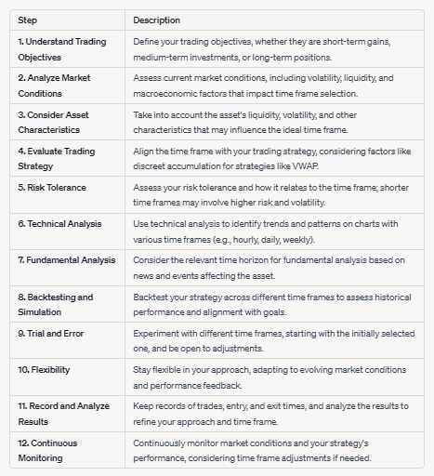
Strategies for Selecting the Optimal Trading Time Frame
Remember that the optimal time frame may vary from one trader to another and from one asset to another. It's essential to align your time frame with your trading goals, risk tolerance, and the specific strategy you're implementing.
Notes:
Observe and define the ideal trading time frame, assess trading objectives, market conditions, asset characteristics, risk tolerance, and strategy alignment, and continuously adapt based on analysis and flexibility.
Observing and defining the time frame for trading, such as when implementing the VWAP (Volume-Weighted Average Price) algorithmic trading strategy, requires a combination of market analysis, trading goals, and risk considerations. Here are steps to observe and define the time frame:
Understand Trading Objectives:
Begin by clearly defining your trading objectives. Are you looking for short-term gains, medium-term investments, or long-term positions? Your objectives will influence your choice of time frame.
Analyze Market Conditions:
Assess the current market conditions, including volatility, liquidity, and macroeconomic factors. Different time frames may be more suitable for specific market environments.
Consider Asset Characteristics:
Take into account the characteristics of the asset you intend to trade. Highly liquid assets may be suitable for short-term trading, while less liquid assets may require longer time frames.
Evaluate Trading Strategy:
Your trading strategy plays a crucial role in determining the time frame. For strategies like VWAP, shorter time frames (e.g., intraday) are often preferred for discreet accumulation.
Risk Tolerance:
Assess your risk tolerance. Shorter time frames may involve higher volatility and risk, while longer time frames may be more stable but require greater patience.
Technical Analysis:
Use technical analysis to identify potential entry and exit points. Different time frames on charts (e.g., hourly, daily, weekly) can provide insights into trends and patterns.
Fundamental Analysis:
If you base your trades on fundamental analysis, consider the time horizon for relevant news and events affecting the asset.
Backtesting and Simulation:
Backtest your trading strategy over various time frames to evaluate historical performance and identify time frames that align with your goals.
Trial and Error:
Start with a time frame that aligns with your initial analysis and objectives. If it doesn't yield the desired results, be prepared to adjust and experiment with different time frames.
Flexibility:
Remain flexible in your approach. Markets evolve, and what works well in one time frame may need adjustment in another.
Record and Analyze Results:
Keep records of your trades, including entry and exit times. Analyze the results to refine your approach over time.
Continuous Monitoring:
Continuously monitor market conditions, news, and your strategy's performance. Be open to adapting your time frame if necessary.
Remember that the optimal time frame may vary from one trader to another and from one asset to another. It's essential to align your time frame with your trading goals, risk tolerance, and the specific strategy you're implementing.

Slide 16
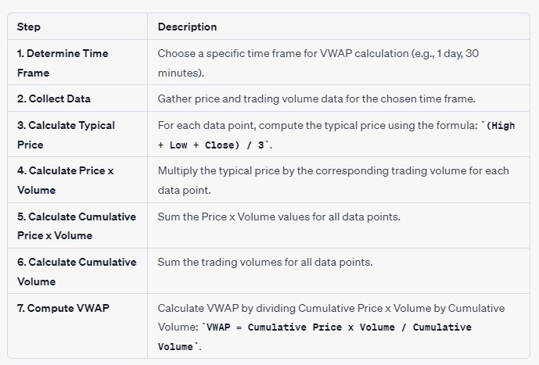
Calculating VWAP: A Weighted Average Price Indicator
This table outlines the step-by-step process for calculating VWAP, a valuable indicator for assessing the average trading price weighted by volume over a specified time frame.
Notes:
VWAP (Volume-Weighted Average Price) is calculated by taking the sum of the products of typical prices and trading volumes over a specified time frame, divided by the sum of trading volumes, providing an average price indicator for traders.
The Volume-Weighted Average Price (VWAP) is calculated using a formula that takes into account the trading volume and price of an asset over a specified time frame. To calculate VWAP, follow these steps:
Determine the Time Frame: Decide on the time frame for which you want to calculate the VWAP (e.g., 1 day, 30 minutes, etc.).
Collect Data: Gather the following data for the specified time frame:
Price: Record the price of the asset at each trade or at regular intervals within the time frame.
Volume: Note the trading volume (number of shares or contracts) for each trade or interval.
Calculate the Typical Price: For each data point, calculate the typical price using the following formula:
Typical Price = (High + Low + Close) / 3
High: The highest price during the time interval.
Low: The lowest price during the time interval.
Close: The closing price at the end of the time interval.
4. Calculate the Price x Volume: Multiply the typical price by the corresponding trading volume for each data point:
Price x Volume = Typical Price * Volume
5. Calculate the Cumulative Price x Volume: Sum the Price x Volume values for all data points within the chosen time frame.
6 Calculate the Cumulative Volume: Sum the trading volumes for all data points within the chosen time frame.
7. Compute VWAP: Finally, calculate the VWAP by dividing the Cumulative Price x Volume by the Cumulative Volume:
VWAP = Cumulative Price x Volume / Cumulative Volume
The resulting VWAP represents the average price at which the asset was traded over the specified time frame, weighted by trading volume. It is a valuable indicator for traders and investors to assess the average price at which trading occurred during a given period and can be used for making trading decisions.

Slide 17
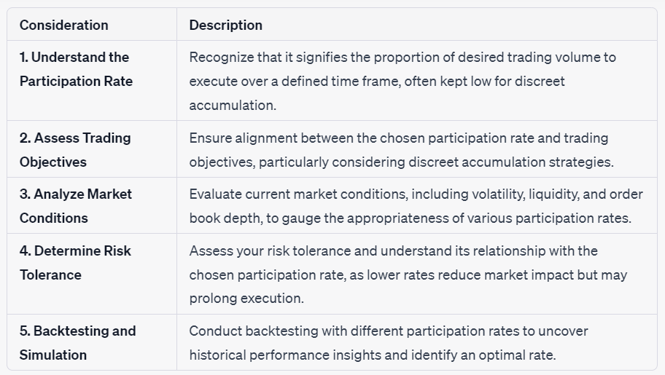
Set Participation Rate
Structured approach to optimize execution & minimize market impact.
Notes:
Setting the participation rate in algorithmic trading involves aligning the proportion of desired trading volume with trading objectives, assessing market conditions, considering risk tolerance, and optimizing based on historical performance.
These steps provide a structured approach to setting the participation rate in algorithmic trading, allowing traders to optimize execution while minimizing market impact.
Setting the participation rate in algorithmic trading involves determining the rate at which you want to participate in the market. This rate influences the speed at which you execute your trading strategy. Here's how to set the participation rate:
Understand the Participation Rate:
The participation rate represents the proportion of your desired trading volume that you want to execute in the market over a specific time frame. For discreet asset accumulation, it is typically set at a low percentage.
Assess Trading Objectives:
Consider your trading objectives and the strategy you're implementing. Your objectives should align with the chosen participation rate. For example, discreet accumulation strategies may require a very low participation rate.
Analyze Market Conditions:
Evaluate the current market conditions, including volatility, liquidity, and order book depth. More liquid markets may allow for a higher participation rate.
Determine Risk Tolerance:
Assess your risk tolerance and how it relates to the chosen participation rate. Lower participation rates reduce the risk of market impact but may take longer to execute large orders.
Backtesting and Simulation:
Backtest your trading strategy with various participation rates to see how it would have performed historically. This can help you identify an optimal rate.
Real-time Monitoring:
Continuously monitor your trades in real time when executing with the chosen participation rate. Be prepared to make adjustments if market conditions change.
Trial and Error:
Initially, you may need to experiment with different participation rates to find the one that achieves your objectives while minimizing market impact.
Flexibility:
Remain flexible and adaptable. Market conditions can change, and you may need to adjust the participation rate as needed.
Use Algorithmic Tools:
Utilize algorithmic trading tools and platforms that allow you to set and automate your chosen participation rate. This can help maintain consistency in execution.
Risk Management:
Implement risk management measures, such as stop-loss orders, to protect your positions when using a low participation rate.
Continuous Assessment:
Continually assess the chosen participation rate's impact on your trading strategy's performance and adjust it as necessary.
Remember that the optimal participation rate can vary depending on the specific asset, market conditions, and your trading goals. It's essential to find the right balance between discreet accumulation and timely execution based on your unique circumstances.

Slide 18
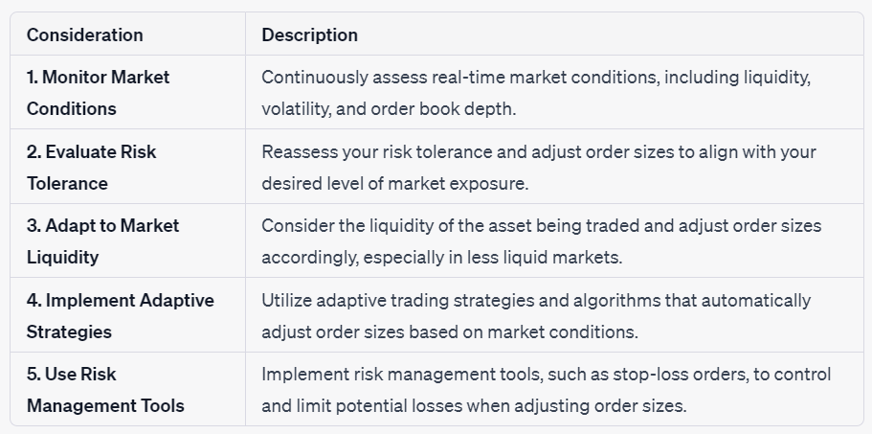
Adjust Order Sizes
Notes:
Adjusting order sizes in algorithmic trading involves continuously monitoring market conditions, aligning order sizes with risk tolerance, adapting to asset liquidity, utilizing adaptive strategies, and implementing risk management tools to optimize trading strategy performance.
These considerations are crucial for effectively managing order sizes in algorithmic trading and optimizing trading strategy performance.
Adjusting order sizes in algorithmic trading is essential for optimizing trading strategies based on various factors, including market conditions, risk management, and specific objectives. Here's how to adjust order sizes effectively:
Monitor Market Conditions:
Continuously monitor real-time market conditions, including liquidity, volatility, and order book depth, as they can significantly impact order size decisions.
Evaluate Risk Tolerance:
Reassess your risk tolerance and determine how changes in order sizes may affect your exposure to market risk. Adjust orders to align with your risk tolerance.
Adapt to Market Liquidity:
Consider the liquidity of the asset you are trading. In less liquid markets, smaller order sizes may be necessary to avoid excessive market impact.
Implement Adaptive Strategies:
Utilize adaptive trading strategies and algorithms that automatically adjust order sizes based on market conditions and trading goals.
Use Risk Management Tools:
Implement risk management tools, such as stop-loss orders or position limits, to control and limit potential losses when adjusting order sizes.
Review Strategy Performance:
Regularly review the performance of your trading strategy and analyze how order size adjustments impact execution efficiency and profitability.
Backtesting and Simulation:
Conduct backtesting and simulation with different order sizes to understand their historical impact on strategy performance.
Trial and Error:
Experiment with incremental changes to order sizes while monitoring their impact on execution quality and market impact.
Consult with Experts:
Seek advice from experienced traders, quantitative analysts, or algorithmic trading experts to gain insights into optimizing order sizes.
Maintain Flexibility:
Stay flexible and adaptable in your approach, ready to fine-tune order sizes based on evolving market conditions and objectives.
Algorithmic Trading Tools:
Leverage algorithmic trading platforms and tools that allow for efficient adjustments to order sizes and automate the process.
Consider Regulatory Compliance:
Ensure that any adjustments made to order sizes comply with relevant financial regulations and exchange rules.
Record and Analyze Results:
Keep comprehensive records of trading activity, order size adjustments, and their impact on performance to make data-driven decisions.
Remember that the optimal order size can vary depending on the asset being traded, market dynamics, and your specific trading strategy. Regularly reviewing and adjusting order sizes is crucial for maintaining trading efficiency and risk management in algorithmic trading.

Slide 19
Execute Orders
Execute orders confidentially, minimize market impact strategically.
Algorithmic trading: Executive orders confidentiality, and minimizes market impact using dark pools, federated learning, differential privacy, and more.
Notes:
How to adjust participation rate and order sizes?
Define the Time Frame: Specify the time frame over which you want to accumulate the asset, such as a day or a week.
Calculate VWAP: Calculate the VWAP for the asset over the defined time frame. VWAP is the average price of all trades in a given period, weighted by their trading volume.
Set Participation Rate: Determine the rate at which you want to participate in the market. For discreet accumulation, this rate should be low to avoid drawing attention.
Execute Orders: Break down the order into smaller orders, typically executed as limit orders at or near the calculated VWAP. These orders are placed throughout the defined time frame.
Monitor and Adjust: Continuously monitor the execution of orders and adjust the participation rate or order sizes based on market conditions. If the asset's price moves away from the VWAP, adjust order prices accordingly.

Slide 20
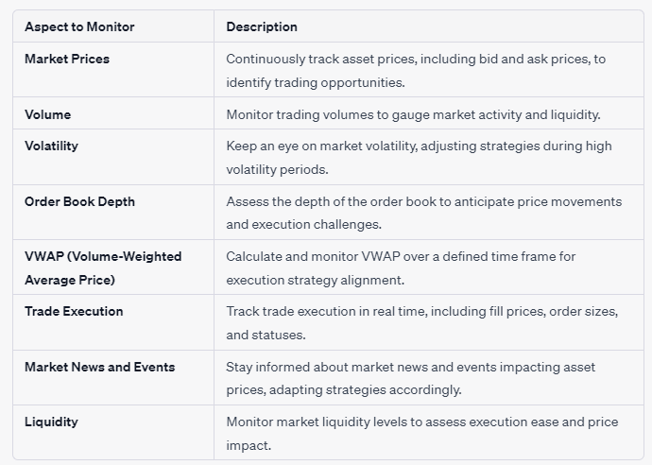
Comprehensive Monitoring
These top 8 items represent critical aspects to monitor in algorithmic trading for effective decision-making and strategy optimization.
Notes:
what to monitor
In algorithmic trading, continuous monitoring encompasses tracking market prices, volumes, volatility, order book depth, VWAP, trade execution, news and events, liquidity, risk metrics, algorithm performance, execution costs, order statuses, price deviations, position management, compliance, backtesting results, market microstructure, and real-time adjustments to optimize strategy execution and outcomes.
These top 8 items represent critical aspects to monitor in algorithmic trading for effective decision-making and strategy optimization.
In algorithmic trading, monitoring various aspects of the market and your trading strategy is essential to make informed decisions and optimize performance. Here's a list of what to monitor:
Market Prices: Continuously track the prices of the assets you're trading, including bid and ask prices, to identify potential trading opportunities and deviations from your target prices.
Volume: Monitor trading volumes to gauge market activity and liquidity. Higher volumes often indicate increased market interest and potential for more significant price movements.
Volatility: Keep an eye on market volatility, as it can affect the speed and execution quality of your trades. Adjust your strategies accordingly during periods of high volatility.
Order Book Depth: Assess the depth of the order book to understand the supply and demand for an asset. This can help you anticipate price movements and execution challenges.
VWAP (Volume-Weighted Average Price): Continuously calculate and monitor the VWAP over your defined time frame to ensure your trades align with your execution strategy.
Trade Execution: Track the execution of your trades in real time, including fill prices, order sizes, and order statuses. Ensure that your orders are being executed as planned.
Market News and Events: Stay informed about relevant market news, economic events, and announcements that could impact asset prices. Adjust your strategy based on new information.
Liquidity: Monitor liquidity levels in the market to assess the ease of executing your trades without causing significant price changes.
Risk Metrics: Keep an eye on risk metrics, such as position sizes, leverage, and exposure, to ensure that you are managing risk within acceptable limits.
Algorithm Performance: Continuously analyze the performance of your trading algorithms, including metrics like profitability, slippage, and execution speed.
Execution Costs: Track execution costs, including spreads, commissions, and fees, to assess the overall cost-effectiveness of your trading strategy.
Order Status: Monitor the status of your open orders, including any unfilled or partially filled orders, and take action as needed to adjust your strategy.
Price Deviations: Watch for significant price deviations from your target prices or VWAP and be prepared to adjust your orders accordingly.
Position Management: Keep track of your open positions and assess their performance relative to your trading objectives. Implement position management strategies as necessary.
Compliance and Regulation: Ensure that your trading activities comply with relevant financial regulations and exchange rules. Stay updated on any regulatory changes that may affect your trading.
Backtesting Results: Regularly review the results of your backtests to validate the effectiveness of your trading strategies and identify areas for improvement.
Market Microstructure: Study market microstructure to uncover subtle patterns and trading opportunities while assessing the impact of your orders on the market.
Real-time Adjustments: Be prepared to make real-time adjustments to your trading strategy, order sizes, or participation rates based on changing market conditions.
Trading Platform Performance: Monitor the performance and reliability of your trading platform or software to ensure smooth execution.
Effective monitoring is essential for algorithmic traders to adapt to evolving market conditions, maintain strategy performance, and make timely adjustments to optimize trading outcomes.

Slide 21
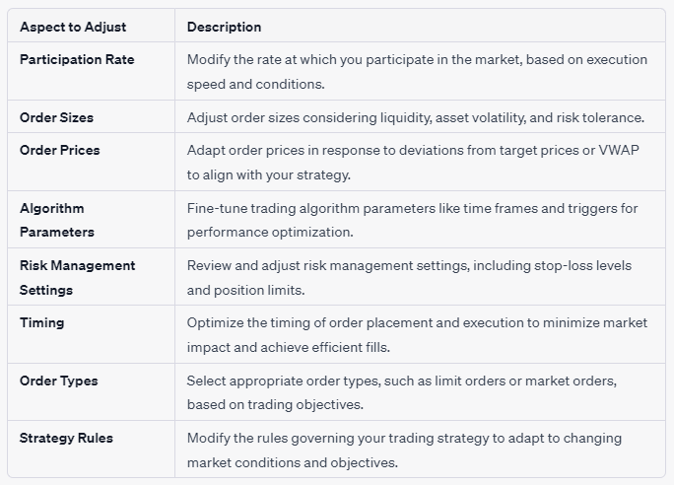
Dynamic Adjustments
Notes:
In algorithmic trading, it is essential to continuously monitor and adjust parameters such as participation rate, order sizes, prices, algorithm parameters, risk management settings, timing, order types, and strategy rules to optimize trading strategies and adapt to dynamic market conditions effectively.
In algorithmic trading, there are several key parameters and elements that traders should be prepared to adjust to optimize their strategies. Here are the primary aspects to consider adjusting:
Participation Rate:
Adjust the rate at which you want to participate in the market, depending on the desired execution speed and market conditions.
Order Sizes:
Modify the size of your orders based on factors such as liquidity, asset volatility, and your risk tolerance.
Order Prices:
Adapt order prices in response to deviations from your target price or VWAP to align with your strategy.
Algorithm Parameters:
Fine-tune the parameters of your trading algorithms, such as time frames, indicators, and triggers, to optimize performance.
Risk Management Settings:
Review and adjust risk management settings, including stop-loss levels and position limits, to control potential losses.
Timing:
Optimize the timing of order placement and execution to minimize market impact and achieve efficient fills.
Order Types:
Select appropriate order types, such as limit orders, market orders, or stop orders, based on your trading objectives.
Strategy Rules:
Modify the rules governing your trading strategy to adapt to changing market conditions and objectives.
Execution Venues:
Choose different execution venues, including dark pools or alternative trading venues, to minimize market impact and enhance confidentiality.
Leverage:
Adjust leverage levels to align with your risk tolerance and overall trading strategy.
Asset Selection:
Consider altering the selection of assets in your portfolio based on market conditions and performance analysis.
Real-time Adjustments:
Be prepared to make real-time adjustments as market conditions change to avoid unexpected outcomes.
Position Sizing:
Determine the appropriate size of positions within your portfolio based on current market conditions and risk assessment.
Trading Frequency:
Modify the frequency of trading activities based on your strategy's objectives and the market's characteristics.
Compliance and Regulation:
Ensure compliance with regulatory requirements and adjust trading practices accordingly in response to regulatory changes.
Monitoring Tools:
Utilize advanced monitoring tools and platforms to facilitate efficient adjustments and real-time decision-making.
Adjusting these aspects requires a deep understanding of your trading strategy, thorough market analysis, and the ability to adapt to evolving market conditions to achieve your trading objectives effectively.

Slide 22
End

Slide 23
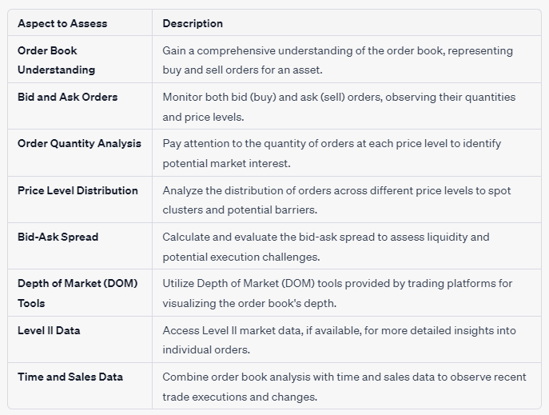
Mastering Order Book Analysis
How to Assess the depth of the order book to anticipate price movements and execution challenges.
Notes:
How to Assess the depth of the order book to anticipate price movements and execution challenges.
To anticipate price movements and address execution challenges in algorithmic trading, assess the order book's depth by analyzing bid and ask orders, order quantities, price distribution, bid-ask spreads, Depth of Market (DOM) tools, Level II data, and time and sales data.
These top 8 items represent critical aspects to consider when assessing the depth of the order book, allowing traders to anticipate price movements and execute orders effectively in algorithmic trading.
Assessing the depth of the order book in algorithmic trading is crucial for anticipating price movements and execution challenges. Here's how to do it:
Understand the Order Book:
Familiarize yourself with the concept of the order book, which represents all buy and sell orders for an asset at various price levels.
Bid and Ask Orders:
Monitor the order book for both bid (buy) and ask (sell) orders. Bid orders are typically listed from highest to lowest prices, while ask orders are listed from lowest to highest prices.
Order Quantity:
Pay attention to the quantity of orders at each price level. Larger order sizes can indicate significant market interest and potential support or resistance levels.
Order Price Levels:
Analyze the distribution of orders across different price levels. Look for clusters of orders that may act as price barriers.
Bid-Ask Spread:
Calculate the bid-ask spread, which is the price difference between the highest bid and the lowest ask. A wider spread may indicate lower liquidity and potential execution challenges.
Depth of Market (DOM) Tools:
Use Depth of Market (DOM) tools provided by trading platforms to visualize the order book and its depth. These tools display order quantities at various price levels.
Level II Data:
Access Level II market data, if available, to gain a more detailed view of the order book. Level II data provides information on individual orders rather than just aggregated quantities.
Time and Sales Data:
Combine order book analysis with time and sales data to observe recent trade executions and identify changes in order book dynamics.
Identify Key Price Levels:
Identify key support and resistance levels within the order book where there is a significant concentration of orders. These levels may influence price movements.
Market Depth Trends:
Analyze trends in market depth over time. Increasing order sizes at certain price levels or a shift in the bid-ask spread can signal changing market sentiment.
Market Impact Assessment:
Consider how executing large orders may impact the order book. Executing a sizable order can lead to price changes as it consumes orders at various price levels.
Order Book Imbalances:
Watch for order book imbalances, where the quantity of buy or sell orders significantly outweighs the other. These imbalances can indicate potential price shifts.
Real-time Monitoring:
Continuously monitor the order book in real time as market conditions evolve. Be prepared to adjust your trading strategy based on new information.
Assessing the depth of the order book requires a combination of data analysis, visualization tools, and a keen understanding of market dynamics. It enables traders to anticipate potential price movements, identify support and resistance levels, and make informed decisions when executing orders.

Slide 24
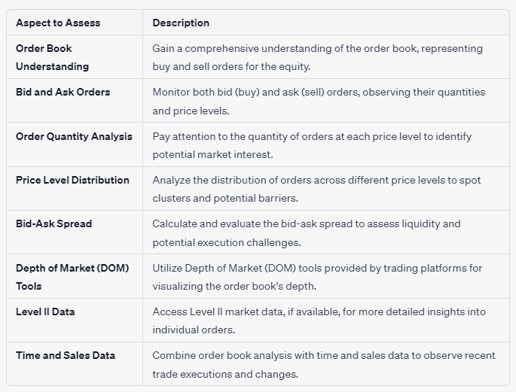
Mastering Order Book Analysis
Notes:
Assessing the depth of the order book for equities involves monitoring bid and ask orders, analyzing order quantities and price distribution, calculating bid-ask spreads, using depth of market (DOM) tools, accessing Level II data, and considering time and sales data to make informed trading decisions.
Assessing the order book for equities allows traders to gain valuable insights into market dynamics, support and resistance levels, liquidity conditions, and recent trading activity, enabling informed trading decisions and algorithmic strategy optimization.
let's explore an example of how to assess the depth of the order book for an equity (stock) in algorithmic trading:
Scenario: You are a trader focusing on a specific tech company's stock, and you want to assess the order book's depth to make informed trading decisions.
Order Book Understanding:
Log in to your trading platform and navigate to the order book for the tech company's stock.
Bid and Ask Orders:
Observe the order book, noting the bid (buy) and ask (sell) orders. Buy orders are typically displayed on the left side, while sell orders are on the right.
Order Quantity Analysis:
Pay attention to the quantities of orders at various price levels. You notice a substantial number of buy orders at a specific price, indicating strong demand for the stock.
Price Level Distribution:
Analyze the distribution of orders across different price levels. You identify a concentration of sell orders just above the current market price, suggesting potential resistance.
Bid-Ask Spread:
Calculate the bid-ask spread by finding the difference between the highest buy order price and the lowest sell order price. A narrow spread implies higher liquidity and smoother execution.
Depth of Market (DOM) Tools:
Utilize Depth of Market (DOM) tools on your trading platform to visualize the order book's depth. These tools provide real-time order quantity data at different price levels.
Level II Data:
If available, access Level II market data to view individual orders, their sizes, and the traders behind them. This can offer additional insights into market dynamics.
Time and Sales Data:
Combine order book analysis with time and sales data to track recent trade executions. You may notice that significant buy orders have been filled recently.
By assessing the order book for the tech company's stock, you gain insights into market sentiment, potential support and resistance levels, liquidity conditions, and recent trading activity. These insights can help you make data-driven decisions when executing your equity trades, contributing to more informed and effective algorithmic trading strategies.

Slide 25
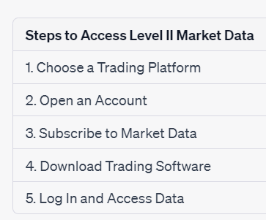
how to Access Level II market data
Notes:
These are the essential steps to access Level II market data and utilize it for trading analysis and decision-making.
Accessing Level II market data provides detailed insights into individual orders and order book depth. To access Level II data, follow these steps:
Choose a Trading Platform:
Select a trading platform or brokerage that offers Level II market data. Not all platforms provide this feature, so ensure it's available with your chosen service.
Open an Account:
If you're not already a customer of the platform, you may need to open a trading account with the selected brokerage. Follow their account opening process.
Subscribe to Market Data:
Check whether the platform offers Level II data as part of its standard services or if it requires a subscription. If needed, subscribe to Level II market data.
Download Trading Software:
Download and install the trading software or platform provided by your chosen brokerage. Ensure that the software includes Level II data functionality.
Log In:
Log in to your trading account using the credentials provided by the brokerage. Make sure you have the necessary permissions to access Level II data.
Navigate to Level II Data:
Once you're logged in, navigate to the section of the trading platform or software where Level II market data is available. This might be labeled as "Level II," "Market Depth," or something similar.
Select the Asset:
Choose the specific asset or security for which you want to access Level II data. This can include stocks, options, or other instruments.
View Level II Data:
The Level II data display will typically show a list of buy and sell orders, including their prices, quantities, and order types. You can often see the highest bid and lowest ask prices as well.
Customize the Display:
Many trading platforms allow you to customize the Level II data display. You can adjust the number of price levels shown, choose different color schemes, and set alert thresholds.
Analyze and Trade:
With Level II data at your disposal, you can analyze the order book, identify support and resistance levels, and make informed trading decisions. This data is especially valuable for day traders and active traders.
Stay Informed:
Continue to monitor the Level II data in real time while trading. Be aware that Level II data can change rapidly, so staying informed is essential for timely decision-making.
Remember that accessing Level II market data may incur additional fees, so be sure to review the pricing structure of your chosen brokerage or trading platform. Additionally, Level II data can be complex, so it's recommended for experienced traders who are familiar with interpreting order book dynamics.

Slide 26
Position Management
Steps
Open Position Monitoring
Trading Objectives Review
Stop-Loss Orders
Take-Profit Orders
Risk-Reward Ratio Assessment
Trailing Stop Orders
Partial Profit-Taking
Diversification
Real-time Monitoring
Position Sizing
Record-Keeping
Adapt to Market Conditions
Emotional Discipline
Effective position management in trading involves continuous monitoring of open positions, alignment with trading objectives, setting stop-loss and take-profit orders, assessing risk-reward ratios, using trailing stops, and practicing emotional discipline to make informed decisions.
Notes:
how to Track open positions and assess their alignment with trading objectives. I
Effective position management is a fundamental component of trading success, helping you protect your capital, optimize your profits, and ensure that your trading aligns with your objectives and risk tolerance
Effective position management in trading involves continuous monitoring of open positions, alignment with trading objectives, setting stop-loss and take-profit orders, assessing risk-reward ratios, using trailing stops, and practicing emotional discipline to make informed decisions.
These position management steps are essential for optimizing trading performance and aligning your open positions with your trading objectives and risk management practices.
Tracking open positions and ensuring they align with your trading objectives is a crucial aspect of successful trading. Implementing effective position management involves the following steps:
Open Position Monitoring:
Regularly monitor your open positions in real time through your trading platform. Ensure you have access to up-to-date information on each position, including the asset's current price, your entry price, and the position size.
Trading Objectives Review:
Revisit and reaffirm your trading objectives. Your objectives may include profit targets, stop-loss levels, time frames, and risk tolerance. Ensure your open positions align with these objectives.
Stop-Loss Orders:
Implement stop-loss orders for each open position to limit potential losses. Set these orders at levels that align with your risk tolerance and trading plan. Adjust stop-loss levels as needed based on market conditions.
Take-Profit Orders:
Set take-profit orders to secure profits when the asset reaches your predetermined target price. These orders help you lock in gains and adhere to your profit objectives.
Risk-Reward Ratio Assessment:
Evaluate the risk-reward ratio for each open position. Ensure that the potential reward justifies the risk you are taking. Adjust position sizes or objectives if necessary to maintain a favorable risk-reward ratio.
Trailing Stop Orders:
Consider using trailing stop orders to automatically adjust your stop-loss level as the asset's price moves in your favor. This allows you to capture profits while protecting against reversals.
Partial Profit-Taking:
When a position is in profit, consider taking partial profits while leaving a portion of the position open to capture potential further gains. This strategy can help manage risk and secure some profits.
Diversification:
Review your overall portfolio to ensure it remains diversified and aligned with your trading objectives. Avoid overconcentration in a single asset or sector.
Real-time Monitoring:
Continuously monitor the market and your open positions in real time. Be prepared to act swiftly if market conditions change or if your objectives are met.
Position Sizing:
Use proper position sizing techniques to determine the appropriate size for each trade based on your risk tolerance and the distance to your stop-loss level.
Record-Keeping:
Maintain detailed records of your open positions, including entry prices, stop-loss levels, take-profit levels, and trade rationale. This helps with performance analysis and decision-making.
Adapt to Market Conditions:
Be flexible and adapt your position management strategies as market conditions evolve. Different market environments may require different approaches.
Emotional Discipline:
Avoid emotional trading decisions. Stick to your predetermined position management plan, even if emotions urge you to deviate.
Effective position management is a fundamental component of trading success, helping you protect your capital, optimize your profits, and ensure that your trading aligns with your objectives and risk tolerance.
summaryin a table
ChatGPT
Certainly, here's a summary of how to track open positions and implement position management in a table format:
Position Management StepsDescription1. Open Position MonitoringContinuously monitor your open positions in real-time, keeping track of each position's current status.2. Trading Objectives ReviewReevaluate and confirm that your open positions align with your predefined trading objectives and goals.3. Stop-Loss OrdersImplement stop-loss orders for each open position to limit potential losses, adjusting them as needed.4. Take-Profit OrdersSet take-profit orders to secure profits at your target price levels, adhering to your profit objectives.5. Risk-Reward Ratio AssessmentEvaluate the risk-reward ratio for each position, ensuring it justifies the risk taken and adjusting if necessary.6. Trailing Stop OrdersConsider trailing stop orders to adjust stop-loss levels as the asset's price moves in your favor.7. Partial Profit-TakingTake partial profits when positions are in profit, while leaving a portion open for further gains.8. DiversificationReview your portfolio to maintain diversification and avoid overconcentration in a single asset or sector.9. Real-time MonitoringContinuously monitor positions and market conditions in real-time, prepared to adapt to changing circumstances.10. Position SizingCalculate position sizes based on risk tolerance and stop-loss levels to ensure appropriate trade sizing.11. Record-KeepingMaintain comprehensive records of positions, including entry prices, stop-loss, take-profit levels, and rationale.12. Adapt to Market ConditionsStay flexible and adjust position management strategies to align with evolving market conditions.13. Emotional DisciplineMaintain emotional discipline and stick to your predetermined position management plan regardless of emotions.These position management steps are essential for optimizing trading performance and aligning your open positions with your trading objectives and risk management practices.

Slide 27
Deciphering Market Microstructure: Analysing Order Impact and Patterns
Steps in Studying Market Microstructure
1. Understand Market Microstructure
2. Data Collection
3. Order Book Analysis
4. Trade Data Analysis
5. Market Participant Behavior
6. Market Impact Assessment
7. Liquidity Analysis
8. Time and Sales Data Analysis
9. Tick Data Analysis
10. Event Studies
11. Statistical Analysis
12. Machine Learning and Data Visualization
13. Continuous Monitoring
14. Research and Literature
15. Risk Management
Study market microstructure to uncover patterns and assess order impact on the market.
These steps provide a structured approach to comprehensively analyze market microstructure, helping traders, investors, and institutions gain valuable insights for informed decision-making and risk management.
Notes:
Study market microstructure to uncover patterns and assess order impact on the market.
Studying market microstructure involves systematically analyzing order books, trade data, and market participant behavior to uncover patterns and assess the impact of orders on the market, providing valuable insights for traders and investors.
These steps provide a structured approach to comprehensively analyze market microstructure, helping traders, investors, and institutions gain valuable insights for informed decision-making and risk management.
Studying market microstructure to uncover patterns and assess order impact on the market involves a systematic approach. Here are the key steps:
Understand Market Microstructure:
Gain a solid understanding of market microstructure, which encompasses the mechanics and dynamics of financial markets, including order types, market participants, and trading venues.
Data Collection:
Acquire relevant market data, including trade data, order book data, and time and sales data, from reputable sources or data providers.
Order Book Analysis:
Analyze the order book for the asset of interest, focusing on the distribution of buy and sell orders at various price levels. Look for patterns, clusters, and shifts in order quantities.
Trade Data Analysis:
Examine trade data to identify patterns in trade executions, such as trade sizes, trade frequency, and the timing of trades. Pay attention to the impact of large trades on the market.
Market Participant Behavior:
Study the behavior of different market participants, including retail traders, institutional investors, market makers, and high-frequency traders. Identify their trading strategies and order flow.
Market Impact Assessment:
Assess the impact of large orders on the market. Look at how the execution of significant orders affects price movements, bid-ask spreads, and market volatility.
Liquidity Analysis:
Evaluate market liquidity by examining the depth of the order book and how it changes over time. Identify liquidity providers and their roles.
Time and Sales Data:
Analyze time and sales data to track the sequence of trades, including the direction (buy or sell) and the order size. Observe how trades are clustered.
Tick Data Analysis:
Utilize tick data to study the price movements at the most granular level. Look for patterns in price changes, order flow, and market reactions.
Event Studies:
Conduct event studies to assess how specific market events or news impact order flow, trading activity, and market behavior.
Statistical Analysis:
Apply statistical techniques and models, such as regression analysis and time-series analysis, to identify correlations, trends, and anomalies in the data.
Machine Learning and Data Visualization:
Employ machine learning algorithms and data visualization tools to uncover complex patterns and relationships in the market microstructure data.
Continuous Monitoring:
Continuously monitor market microstructure data to adapt to changing market conditions and identify emerging patterns or anomalies.
Research and Literature:
Stay informed about academic research and industry literature related to market microstructure. Learn from the experiences and findings of experts in the field.
Risk Management:
Incorporate insights from market microstructure analysis into your risk management strategies to make informed decisions and manage trading risk effectively.
Studying market microstructure requires a combination of quantitative analysis, data interpretation skills, and a deep understanding of market dynamics. It can provide valuable insights for traders, investors, and institutions looking to enhance their trading strategies and risk management practices.

Slide 28
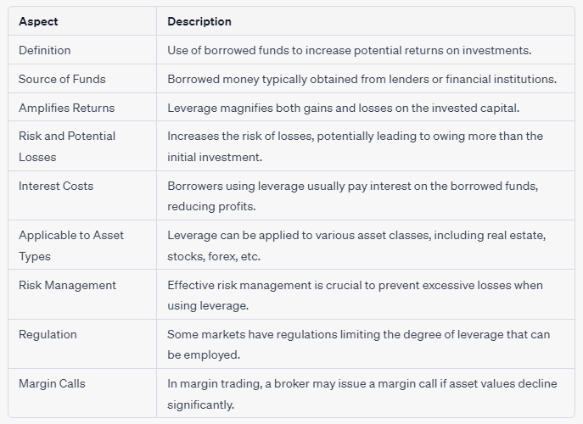
Understanding Leverage in Investments
Notes:
Leverage is the strategy of using borrowed funds to amplify potential investment returns, but it also magnifies the risk of losses and typically involves paying interest on the borrowed capital.
Leverage in finance refers to the use of borrowed funds or debt to increase the potential return on an investment. It allows investors to control a larger position or asset with a relatively smaller amount of their own capital. Leverage can amplify both gains and losses, making it a powerful but potentially risky financial strategy.
Here are some key points to understand about leverage:
Borrowed Funds: Leverage involves borrowing money, typically from a lender or financial institution, to invest in an asset. Common sources of borrowed funds for leverage include mortgages, loans, margin accounts (for stocks), and other forms of debt.
Amplified Returns: By using leverage, investors can control a more extensive asset base than they could with their own funds alone. If the value of the asset increases, the returns on the investment are magnified because the investor benefits from the entire value of the asset, not just their initial investment.
Risk and Potential Losses: While leverage can increase potential gains, it also increases the risk of losses. If the value of the asset decreases, the losses are also amplified, and investors may find themselves owing more than their initial investment (a situation known as a "margin call" in some cases).
Interest Costs: When investors use leverage, they typically have to pay interest on the borrowed funds. These interest costs can eat into the potential profits from the investment.
Asset Types: Leverage can be applied to various types of assets, including real estate, stocks, currencies (in forex trading), and commodities. The specific terms and mechanisms of leverage can vary depending on the asset class and the financial instruments used.
Risk Management: Managing leverage is crucial to avoid excessive risk. Investors should have a clear understanding of their risk tolerance, use leverage conservatively, and have a strategy for risk management in place.
Regulation: In some financial markets, such as securities trading, there are regulations that limit the degree of leverage that can be used. These regulations are intended to protect investors from excessive risk.
Margin Calls: In margin trading (e.g., in the stock market), if the value of the assets purchased with borrowed funds declines significantly, the broker may issue a margin call, requiring the investor to deposit additional funds to cover potential losses.
Leverage can be a valuable tool for experienced investors who understand the risks and have a well-thought-out strategy. However, it can also lead to substantial losses if not used wisely. It's essential to assess your risk tolerance, thoroughly research any investment involving leverage, and consider seeking advice from financial professionals before using leverage in your investment strategy.

Slide 29
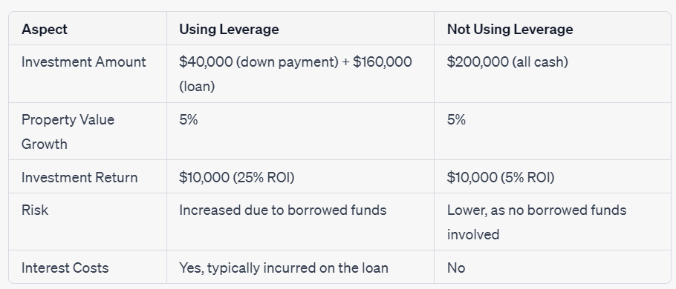
Leverage Comparison: Using vs. Not Using Leverage in Real Estate Investment
Notes:
In a real estate investment example, using leverage by taking out a mortgage with a $40,000 down payment resulted in a higher 25% return on investment (ROI) with a 5% property value growth, while not using leverage with an all-cash investment of $200,000 yielded a lower 5% ROI, highlighting the trade-off between increased returns and higher risk and interest costs associated with leverage.
In this table, it's evident that using leverage resulted in a higher return on investment (ROI) but also increased risk and the obligation to pay interest on the borrowed funds. On the other hand, not using leverage led to a lower ROI but carried lower risk and no interest costs. The decision to use leverage depends on one's risk tolerance and financial goals.

Slide 30
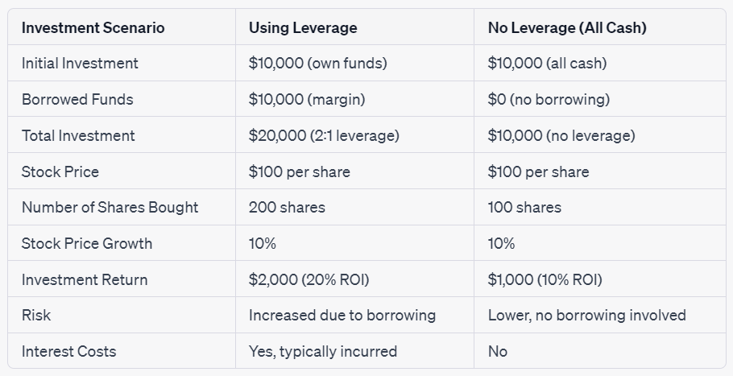
Leverage Comparison: Using vs. Not Using Leverage in Stock Trading
Notes:
In a stock trading example, using leverage with a 2:1 ratio allowed an initial $10,000 investment to control a larger position, resulting in a 20% return on investment with a 10% stock price growth, whereas not using leverage with an all-cash investment of $10,000 yielded a lower 10% return on investment, highlighting the trade-off between increased returns and higher risk and interest costs associated with leverage.
In this table, using leverage resulted in a higher return on investment (ROI) but also increased risk and interest costs associated with borrowing. In contrast, not using leverage resulted in a lower ROI but carried lower risk and no interest costs. The decision to use leverage depends on the investor's risk tolerance and financial goals.

Slide 31
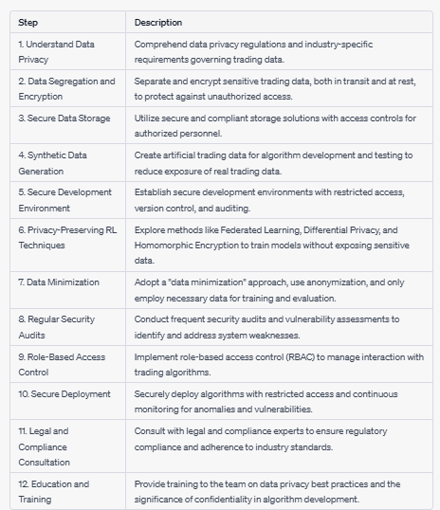
Securing Data Privacy in Customized RL Algorithms for Trading
Developing customized reinforcement learning (RL) algorithms for trading prioritizes data privacy, minimizing the exposure of sensitive trading information while optimizing strategies and enhancing trading confidentiality.
Privacy-Preserving RL Techniques:
Explore privacy-preserving RL techniques, such as Federated Learning, Differential Privacy, and Homomorphic Encryption. These methods allow training RL models without exposing sensitive data to the algorithm.
Notes:
Developing customized reinforcement learning (RL) algorithms for trading prioritizes data privacy, minimizing the exposure of sensitive trading information while optimizing strategies and enhancing trading confidentiality.
Developing customized reinforcement learning (RL) algorithms for trading with a focus on data privacy involves steps such as secure data storage, synthetic data generation, privacy-preserving techniques, and legal consultation to safeguard sensitive trading information while optimizing trading strategies.
This table outlines the crucial steps to follow when developing RL algorithms for trading while emphasizing data privacy and trading confidentiality.
Remember that data privacy and security are ongoing processes. Regularly review and update your data protection measures as regulations evolve and new threats emerge. Prioritizing data privacy in RL algorithm development for trading is essential not only for compliance but also for maintaining trust with clients and stakeholders.
Developing customized reinforcement learning (RL) algorithms for trading with a focus on data privacy and confidentiality involves careful design and implementation. Here's a step-by-step guide on how to approach this task:
Understand Data Privacy Requirements:
Begin by thoroughly understanding the data privacy regulations and requirements that apply to your trading operation. Regulations such as GDPR (General Data Protection Regulation) in Europe and industry-specific rules may impact how you handle sensitive trading data.
Data Segregation and Encryption:
Implement robust data segregation practices to separate sensitive trading information from other data.
Encrypt sensitive data both in transit and at rest to protect it from unauthorized access.
Secure Data Storage:
Utilize secure and compliant storage solutions that meet the data privacy requirements of your industry.
Implement access controls to ensure that only authorized personnel can access sensitive data.
Synthetic Data Generation:
Consider using synthetic data generation techniques to create artificial trading data for algorithm development and testing. This helps minimize the exposure of real trading data.
Secure Development Environment:
Establish secure development environments for your RL algorithms, ensuring that access is restricted to authorized individuals.
Implement version control and auditing to track changes and access to code and data.
Privacy-Preserving RL Techniques:
Explore privacy-preserving RL techniques, such as Federated Learning, Differential Privacy, and Homomorphic Encryption. These methods allow training RL models without exposing sensitive data to the algorithm.
Data Minimization:
Adopt a "data minimization" approach, where only the necessary data required for model training and evaluation is used.
Anonymize or pseudonymize data when possible to further protect individual trading information.
Regular Security Audits:
Conduct regular security audits and vulnerability assessments to identify and address potential weaknesses in your system.
Penetration testing can help assess the security of your algorithms and data infrastructure.
Role-Based Access Control:
Implement role-based access control (RBAC) to ensure that only authorized personnel can interact with and deploy trading algorithms.
Secure Deployment:
When deploying RL trading algorithms, ensure that all connections are secure, and access is restricted.
Continuously monitor the deployed algorithms for any unusual activities or vulnerabilities.
Legal and Compliance Consultation:
Consult with legal and compliance experts to ensure that your RL trading algorithms meet all regulatory requirements and industry standards.
Education and Training:
Provide training to your team on data privacy best practices and the importance of maintaining confidentiality in algorithm development and deployment.
Remember that data privacy and security are ongoing processes. Regularly review and update your data protection measures as regulations evolve and new threats emerge. Prioritizing data privacy in RL algorithm development for trading is essential not only for compliance but also for maintaining trust with clients and stakeholders.

Slide 32
Modify volume for improved trading secrecy

Slide 33
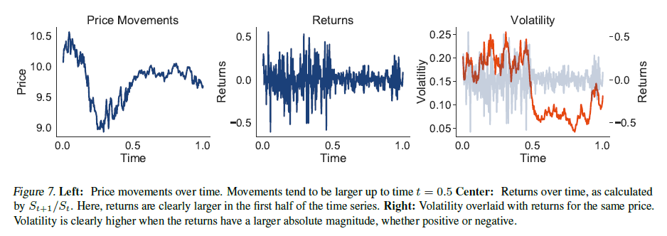
Improved forecasting with volatility-based kernels
[1]. Benton, Gregory, Wesley Maddox, and Andrew Gordon Wilson. “Volatility Based Kernels and Moving Average Means for Accurate Forecasting with Gaussian Processes.” International Conference on Machine Learning. PMLR, 2022. Code

Slide 34
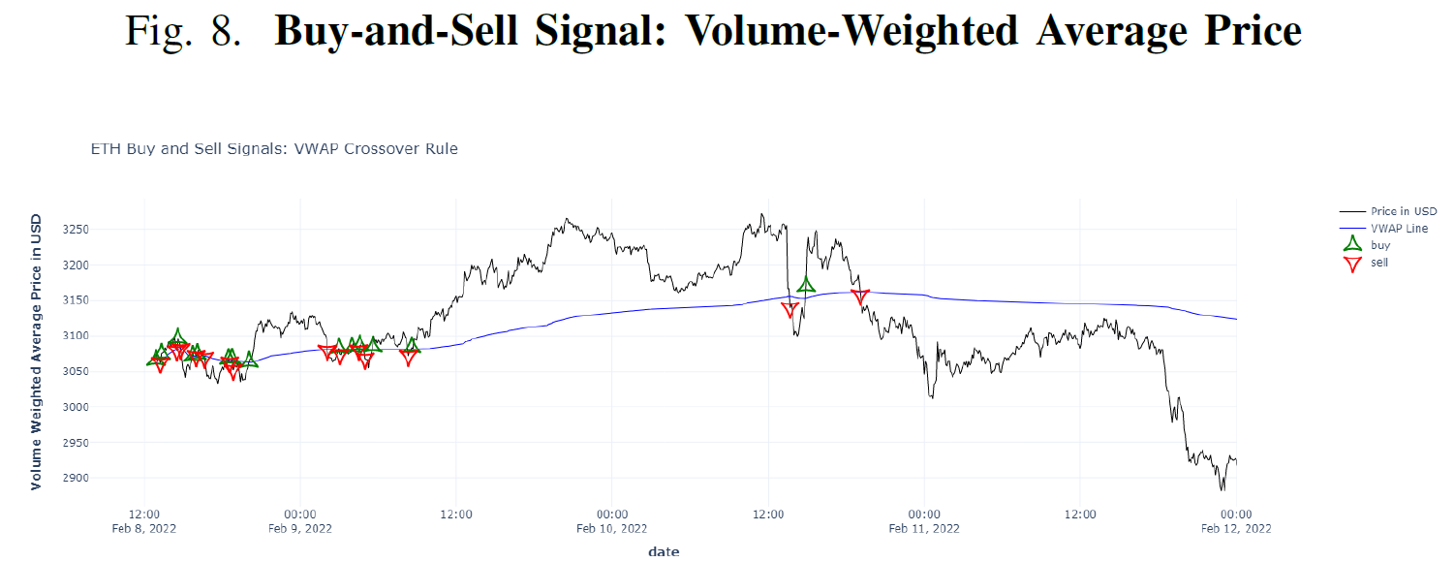
Volume-Weighted Average Price (VWAP)
Zhang, Luyao, et al. "A data science pipeline for algorithmic trading: A comparative study of applications for finance and cryptoeconomics." 2022 IEEE International Conference on Blockchain (Blockchain). IEEE, 2022. Dataset

Slide 35
https://www.researchgate.net/publication/373427239_End-to-end_risk_budgeting_portfolio_optimization_with_neural_networks
https://www.researchgate.net/publication/351803947_Multi-Horizon_Forecasting_for_Limit_Order_Books_Novel_Deep_Learning_Approaches_and_Hardware_Acceleration_using_Intelligent_Processing_Units

Slide 36
Graph neural networks for deep portfolio optimization

Slide 37
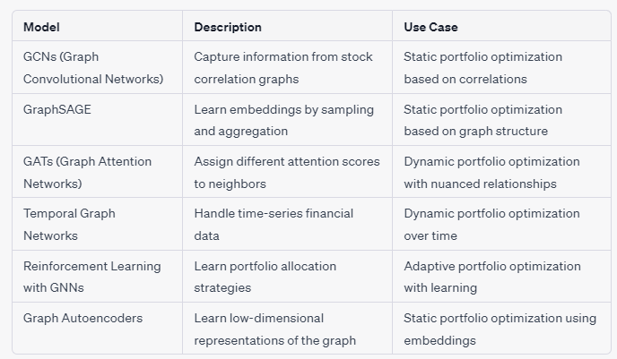
Graph based networks
Knowledge graph for structured data and text data
Graph Neural Networks (GNNs) to improve Knowledge graph with more advanced features.

Slide 38
GATs (Graph Attention Networks)
BATADAL: Cyber Attacks Detection in Water Systems
Search “reinforcement learning stock” in Kaggle, to find some relevant datasets and code:
https://www.kaggle.com/search?q=reinforcement+learning+stock
amazon stock price 2014-2019
apple stock price 5yrs
Stock Market: Historical Data of Top 10 Companies
Huge Stock Market Dataset
Stock Price and Volume IDN
Stock Market Data - Nifty 100 stocks (5 min) data
LIC Stock Price Data
NIFTY FMCG DATA 1 MINUTE 5 MINUTE DAILY DATA
Stock Market (Technical Indicators) Visualization
Deep Reinforcement Learning on Stock Data
Reinforcement Learning Stock Trading
ChatGPT Trading

Slide 39
Search “reinforcement learning stock” in Kaggle, to find some relevant datasets:
Search “Volume Weighted Average Price(VWAP)” to find other 19 relevant datasets for VWAP algorithmic trading strategy, this VWAP strategy is designed to execute trades while minimizing the market impact, which includes keeping the trading activity as discreet as possible. To improve trading secrecy in a VWAP strategy, you can consider the following adjustments: Enhance VWAP trading secrecy with tactics like time slicing, iceberg orders, randomization, and risk management, while ensuring compliance.

